Slide 1
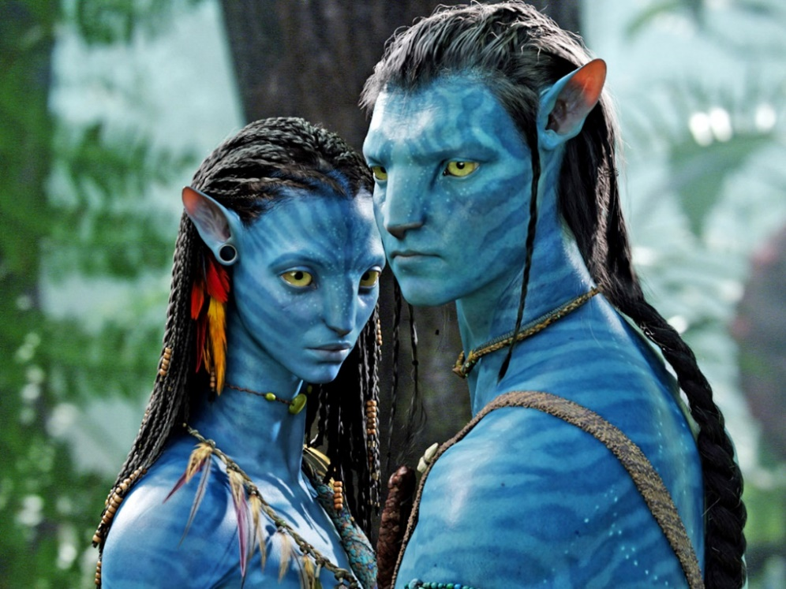
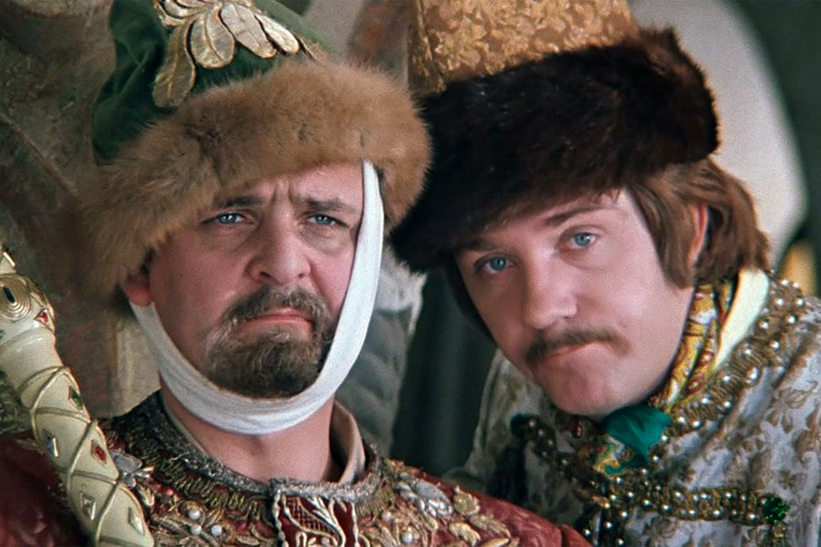
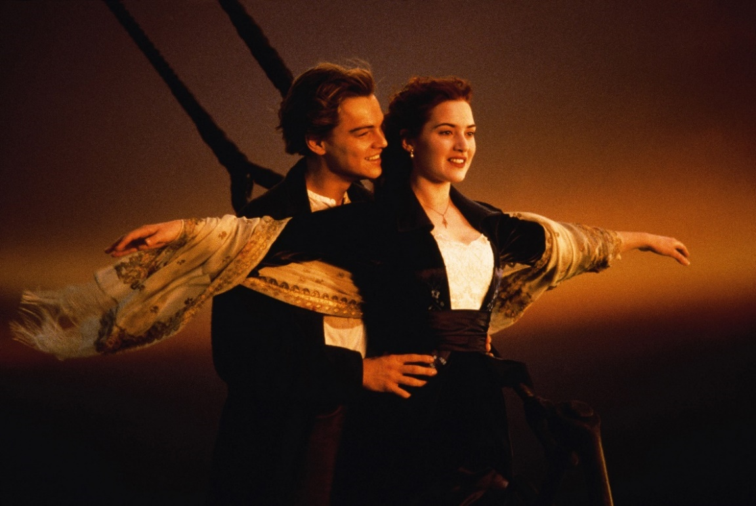
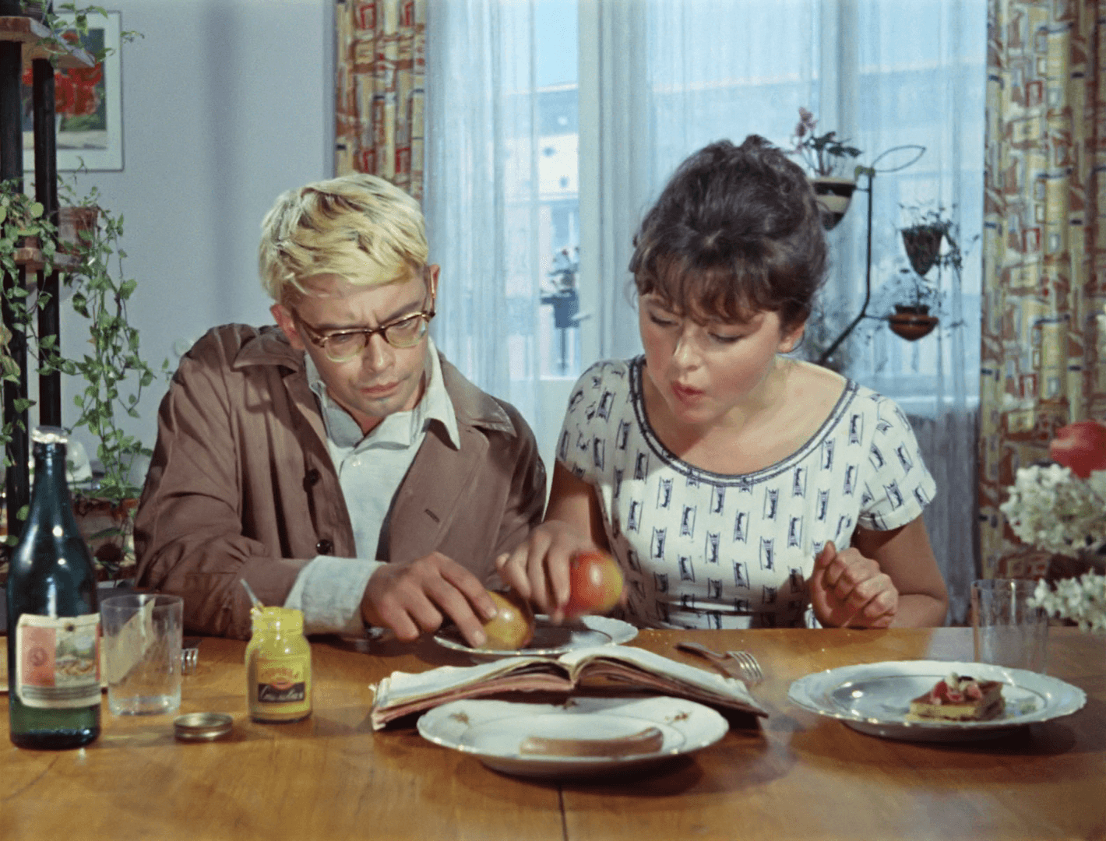
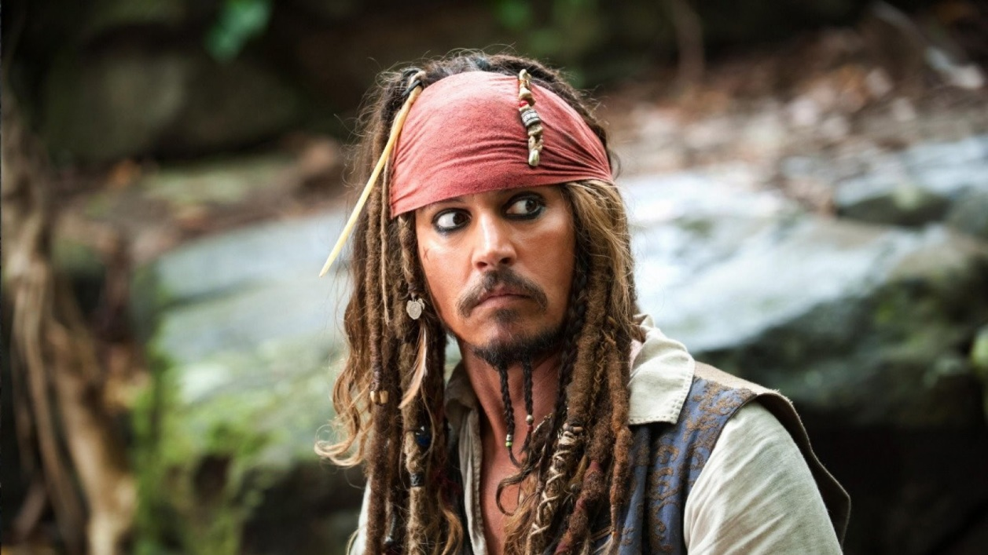
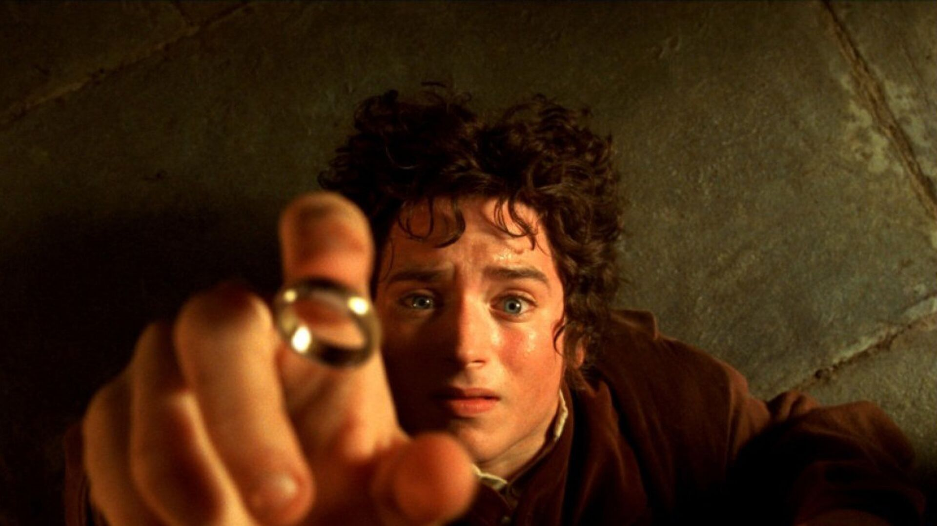

Slide 2
THEME: FILMS
Our aim is:
to learn the words about films and filmmaking by heart
We are going to:
Read and translate the words
Speak about types of films and describe them

Slide 3
MATCH New words WITH THEIR TRANSLATIONS
comedy, action, western, science fiction, mystery, adventure, romance, crime, special effects, plot, acting, set, action-packed, stunts, box office, starring, cast, costumes, scenery, blockbuster, filmmaking, script, location, casting session, crew, visual effects, edit, low-budget, day's shooting, rehearse, team spirit
локация, кастинг, съемочная группа, научная фантастика, кассовые сборы, в главных ролях, мистика, приключения, визуальные эффекты, монтаж, малобюджетный фильм, романтика, криминал, спецэффекты, сюжет, актерская игра, декорации, комедия, боевик, вестерн, захватывающий сюжет, трюки, актерский состав, костюмы, декорации, блокбастер, кинопроизводство, сценарий, актерский состав, дневной съемочный день, репетиция, командный дух

Slide 4
Put the words in the appropriate box
actor, review, actress, director, comedy, producer, scriptwriter, act, cameraman, set designer, horror, costume designer, perform, shoot, western, star in, direct, thriller, actress, make-up artist, produce, musical, animated, adventure, epic
PEOPLE
VERBS
TYPES OF FILMS

Slide 5
Match the types of films with their descriptions
1. In these films characters go through challenges that usually include violence, fighting and chases. The strong hero struggles against villains in life-threatening situations. These films typically ends in victory for the hero.
2. The heroes in such films usually find themselves in exotic locations. They are involved in exciting actions like looking for an unknown land, or trying to save friends or get back home from an inhabitant island.
3. These films are about love and relationships. The characters often have to face some problems to the way to their happiness.
4. In such film the set is often distant planets or even parallel universes. They are about space travel, time travel and supernatural. They are often based on books or scientific theories.
action
adventure
romance
science fiction

Slide 6
Hometask
Learn the words;
Spotlight Тренировочные упражнения p.61-62 ex.5 a, b

