Slide 1
Степанюк Анна Андреевна,
учитель иностранного языка
МАОУ «Аромашевская СОШ
имени Героя Советского Союза
В. Д. Кармацкого»

Slide 2
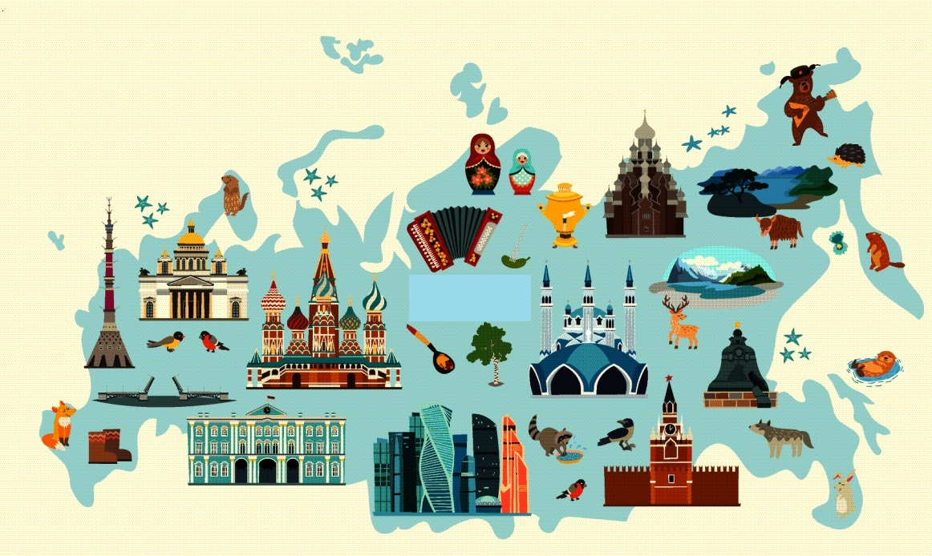

Slide 5
Complete the text with the words after it
Russia is a and beautiful country.
In the South there are and rivers, is in the North. come to Russia to visit Moscow and to enjoy our wonderful .
Russia is a great place to , but also to visit.

Slide 6
COLLECT THE PUZZLES!

Slide 7
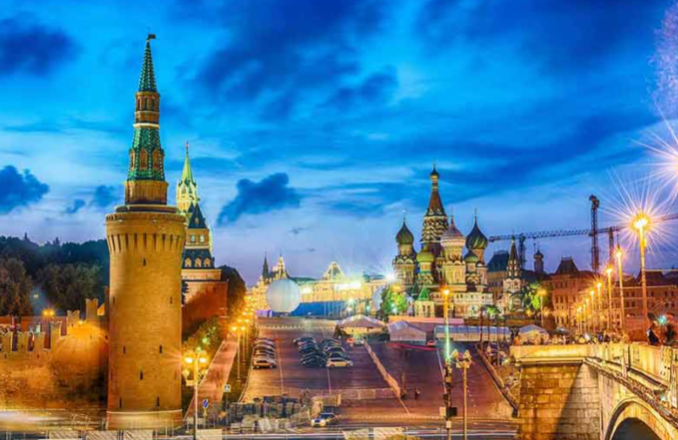
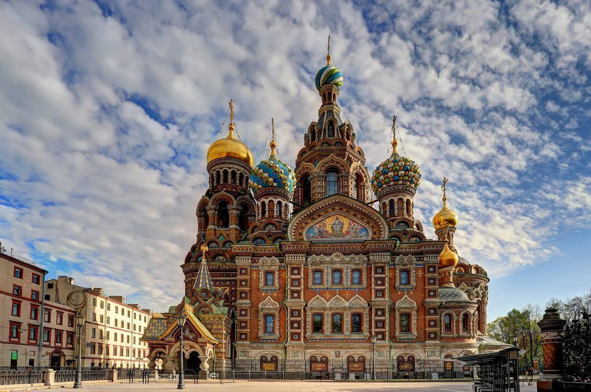
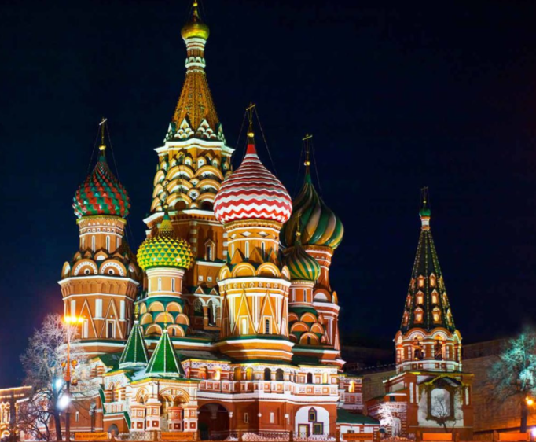
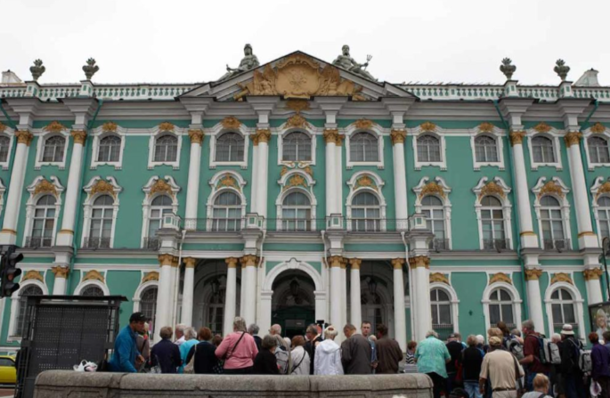
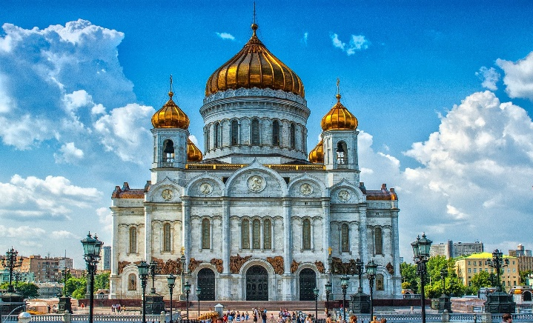
Red Square
The Church of
the Saviour on
Spilled Blood
Saint Basil's
Cathedral
The Hermitage
Museum
The Cathedral
of Christ the
Saviour
The Moscow
Kremlin

Slide 8
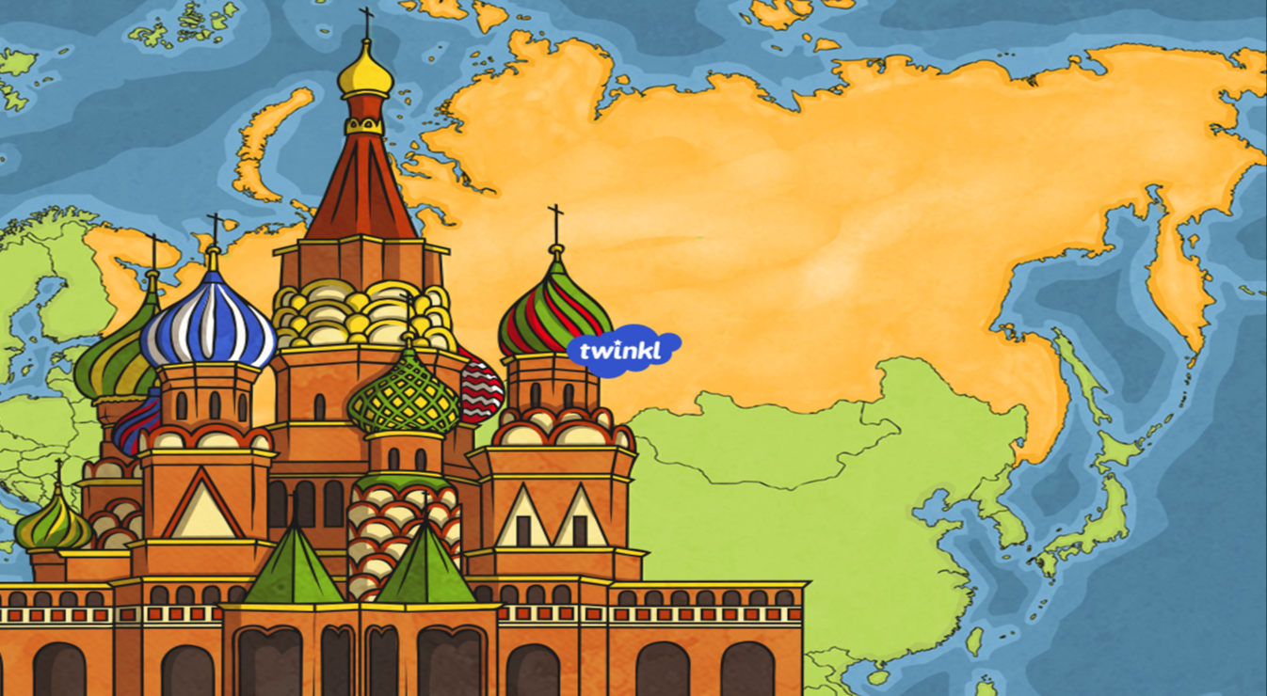
PLACES OF INTEREST
IN RUSSIA

Slide 9
Our aim is:
to learn the places to visit in Russia
We will:
Learn (the words)
Read (the texts)
Write (short texts)
Speak English
Good luck and do your best!

Slide 10
VOCABULARY
dome
to be situated
building
to be built
column
unique
consist of
saviour
palace
highlights
cathedral
century

Slide 11
Work in pairs
PLAN
I would like to tell you about ….
It is situated in….
It was built/ founded in …..
It consists of…

Slide 12
Tell to another pair about the place to visit you have

Slide 13
Did we…?
learn the places of visit in Russia
Learn (the words)
Read (the texts)
Write (short texts)
Speak English
Do our best

Slide 14
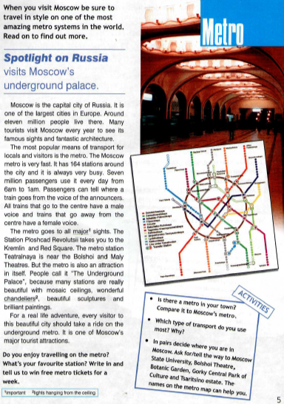
Homework
SB Spotlight on Russia, p.5 (read the text and answer the questions)
Hello my friend, I am writing to you from Russia, and I know you will come soon. You probably want to see the most popular places in Russia? I can advise you to visit ___________ in ________.
________________________
________________________
________________________
Write back soon.
All the best,
(your name)_______.

Slide 15
FILL IN YOUR CHECK LISTS!

Slide 16
Thanks for your work!
Good bye!

